Slide 1
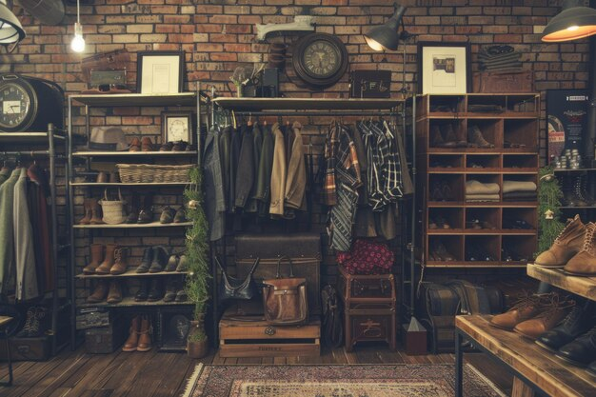

Slide 2
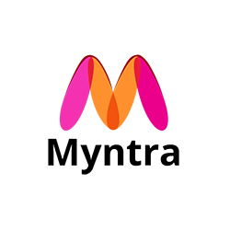
Myntra business model:
Myntra, an e-commerce portal, operates on a business-to-customer (B2C) marketplace model. It allows sellers to sell their products on the platform, while also providing a platform for brands to sell their products at a slight discount.
Brand partnerships:
Myntra has partnered with many well-known brands, including Roadster and Mast & Harbour. Brands pay Myntra to gain visibility on the platform and reach more customers.

Slide 3

Market Position & Growth
Myntra is India's largest fashion e-commerce platform and has a strong market position.
Market share: Myntra is estimated to have a 35–45% market share in India's online fashion market.
The company boasts a significant user presence, with more than 50 million active users, underscoring its extensive reach and popularity.

Slide 4




As the e-commerce fashion market’s share in India’s overall fashion sector rose from 14% to 15% in 2023, Myntra is in a solid position to capture this growth.
Operating revenue grew 25% to INR 4,375.3 Cr in FY23 from INR 3,501.2 Cr in FY22.
Myntra Revenue Model
Myntra spent INR 1,205.9 crore on advertising in the financial year (FY) 2022, which was a 69% increase from the previous year.
In financial year 2023, Myntra reported an operating revenue of 43.75 billion Indian rupees.

Slide 5
Membership & Market place revenue
The primary source of Myntra’s revenue is the commission it earns from third-party sellers and brands for every sale made through its platform. As a marketplace, Myntra takes a percentage of each sale as a commission, and the rate varies depending on the product category and brand.
Myntra is valued at $198M as per the latest available filings
Myntra's revenue for the financial year 2023 was 43.75 billion Indian rupees, which was a 25% increase from the previous year
Membership Revenue (Myntra Insider)-
Myntra Insider is their loyalty program designed to enhance customer retention and increase frequency of purchases.

Slide 6
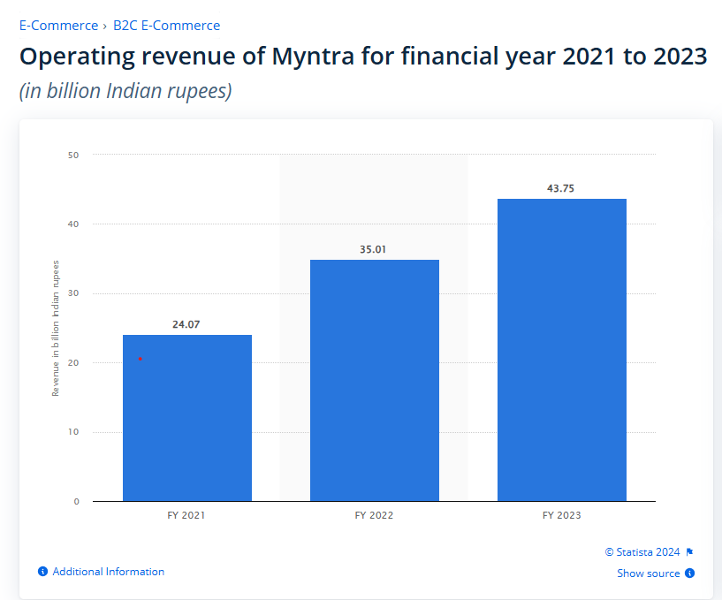
Operating revenue of Myntra from 2021 - 2023

Slide 7
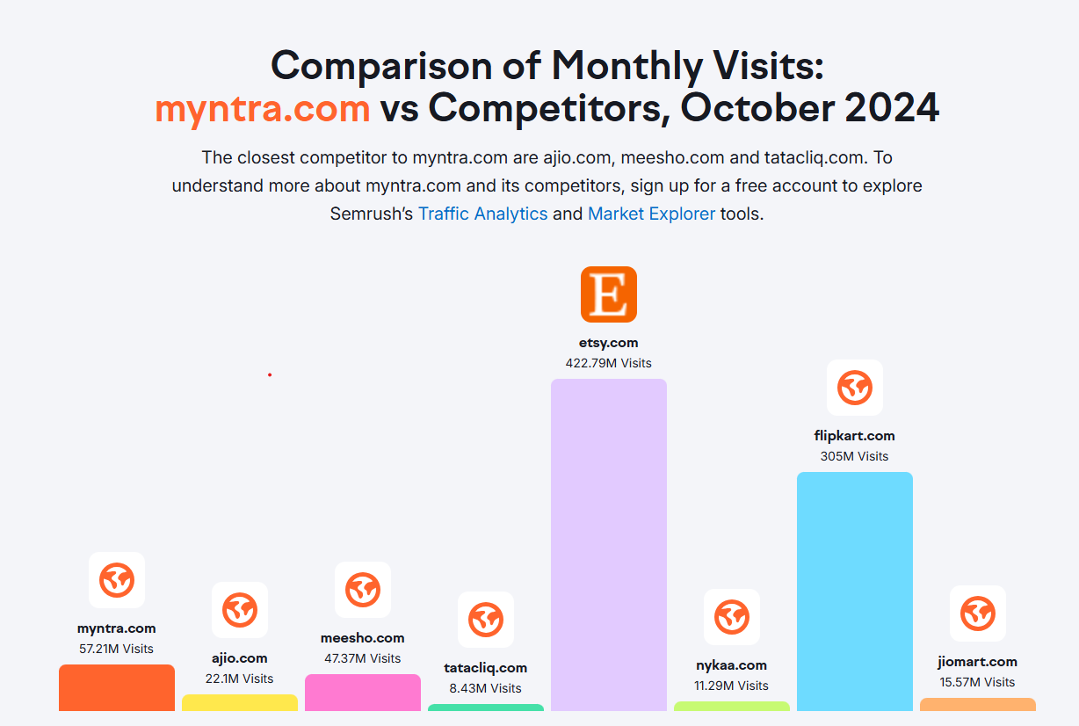
Comparable online stores of Myntra

Slide 8
Technology Utilization
Cloud Computing: Myntra uses scalable cloud infrastructure to handle high traffic during peak sales events like the End of Reason Sale (EORS)
Microservices Architecture: By breaking its platform into microservices, Myntra ensures high availability, faster updates, and improved fault tolerance.
Innovation and Future Technologies
Voice Search: Myntra has integrated voice recognition features, allowing users to search for products using voice commands.
Blockchain for Supply Chain Transparency: The company is exploring blockchain to enhance supply chain transparency and reduce counterfeit products.

Slide 9




DATA ANALYSIS & PERSONALISATION
Big Data Analytics
Sentiment Analysis
Myntra analyses vast amounts of customer data to gain insights into market trends, customer preferences, and pricing strategies.
Through natural language processing (NLP), the platform monitors user reviews and social media feedback to improve products and services.

Slide 10

S
STRENGTHS
Strong Brand Presence
Wide Product Portfolio
Customer Engagement Programs
W
WEAKNESSES
High Return Rates
Limited Reach in Rural Areas
High Dependency on Discounts
O
OPPORTUNITIES
Expansion into Tier-2 and Tier-3 Cities
Increasing Digital Payments Adoption
Cross-Border Expansion
T
THREATS
Intense Competition
Price Wars

Slide 11

Customer Review Analysis
Methodology:
Analysed social media platform like Facebook, YouTube & Instagram and review site like Trustpilot & Google review.
Categorized review into High impact , Low impact & medium impact.
Findings:
High Impact review : Delayed Deliveries Many users reported significant delays in receiving their orders despite multiple follow-ups.
Low Impact review: Simplify and Honor Return Policies Make the return and refund process straightforward and transparent.

Slide 12

Customer based review
Wide Range of Products:
Quality of Products:
Customers frequently appreciate Myntra’s vast collection of clothing and accessories, offering diverse price points and styles.
Product quality is often described as excellent, with items meeting expectations in design, fit, and finish.
High Impact customer review
Good Customer Service:
Timely Deliveries:
Many customers commend Myntra’s easy return and refund processes, noting quick resolution of issues in several instances.
Several users shared positive experiences of faster-than-expected deliveries, with specific appreciation for delivery agents..

Slide 13
Customer based review
Delivery of Incorrect or Used Products:
Return and Refund Challenges:
Reports of receiving wrong items, used or second-hand clothing, and products without tags are common in negative reviews.
Users frequently mention complications with return policies, including false claims of "missing tags" or "failed quality checks" as reasons to deny exchanges or refunds.
Low Impact customer review
Fraud Allegations:
Customer Service Issues:
Some customers accuse Myntra of poor ethics, citing cases of unresponsive escalation teams and unresolved issues with refunds or defective items.
Several reviews criticize unhelpful or automated customer service responses, particularly for escalated complaints.

Slide 14
Customer based review
Strengthen Customer Support:
Address Product Quality Concerns:
Enhance responsiveness and problem resolution in customer service to address recurring issues promptly.
Implement stricter quality control to avoid shipping used or defective items..
Medium Impact customer review
Mixed Experiences:
Improve Delivery Management:
Some customers shared both their positive & negative feedback about the shopping experience.
Ensure accurate delivery timelines and minimize unexpected delays or cancellations.

Slide 15
Competitive Analysis
Competitors:
Nykaa Fashion
Flipkart Fashion
Tata cliq
Ajio
Amazon fashion
Comparison Factors:
Product range & quality
Pricing strategies
Customer service rating
Social media presence and engagement
Competitive Advantages:
Focus on fashion segments
Exclusive Brands & Partnerships
Events & Sales
Challenges Myntra Faces:
Customer Service Complaints
Increasing Competition
Reliance on Discounts

Slide 16
Strategic Recommendation
01
02
03
Customer Engagement
Marketing Strategy
Focus on Sustainable Fashion
Enhance customer service responsiveness.
Introduce loyalty program.
Expand digital marketing efforts with influencer collaboration.
Launch targeted campaigns during festive.
Eco-friendly Collections: There is a growing demand for sustainable products.
Partnerships with Green Brands: Collaborating with brands that focus on sustainability and eco-friendly products

Slide 17

THANK YOU
Sometimes the simplest things mean the most.

